Slide 1
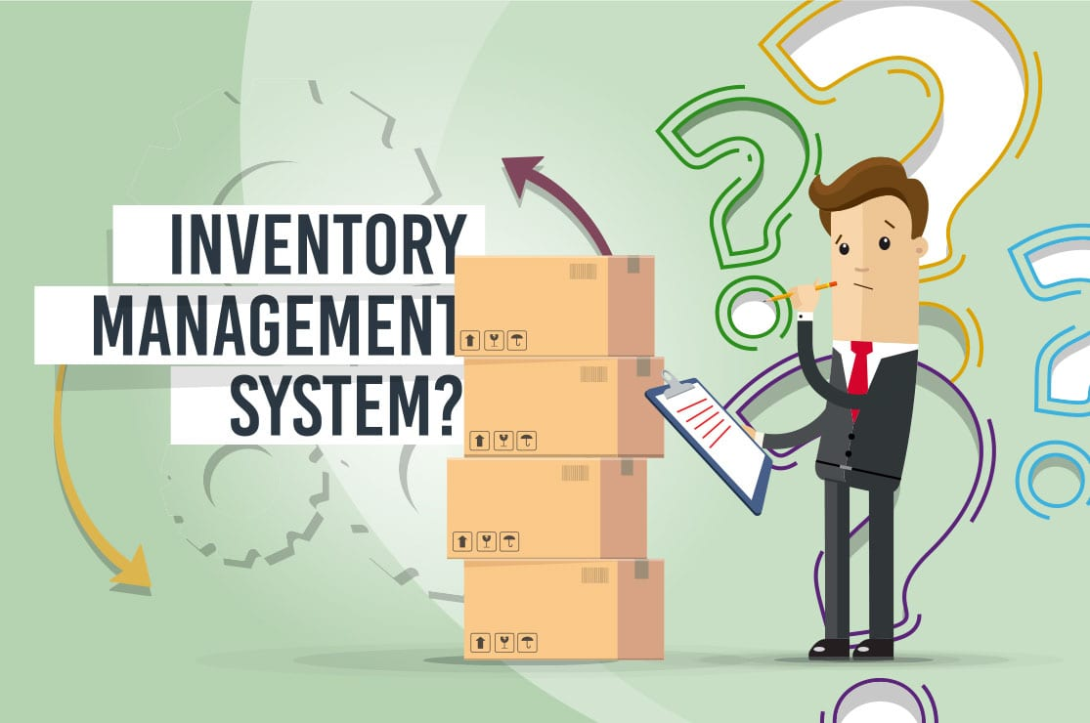
Inventory Management System

Slide 2
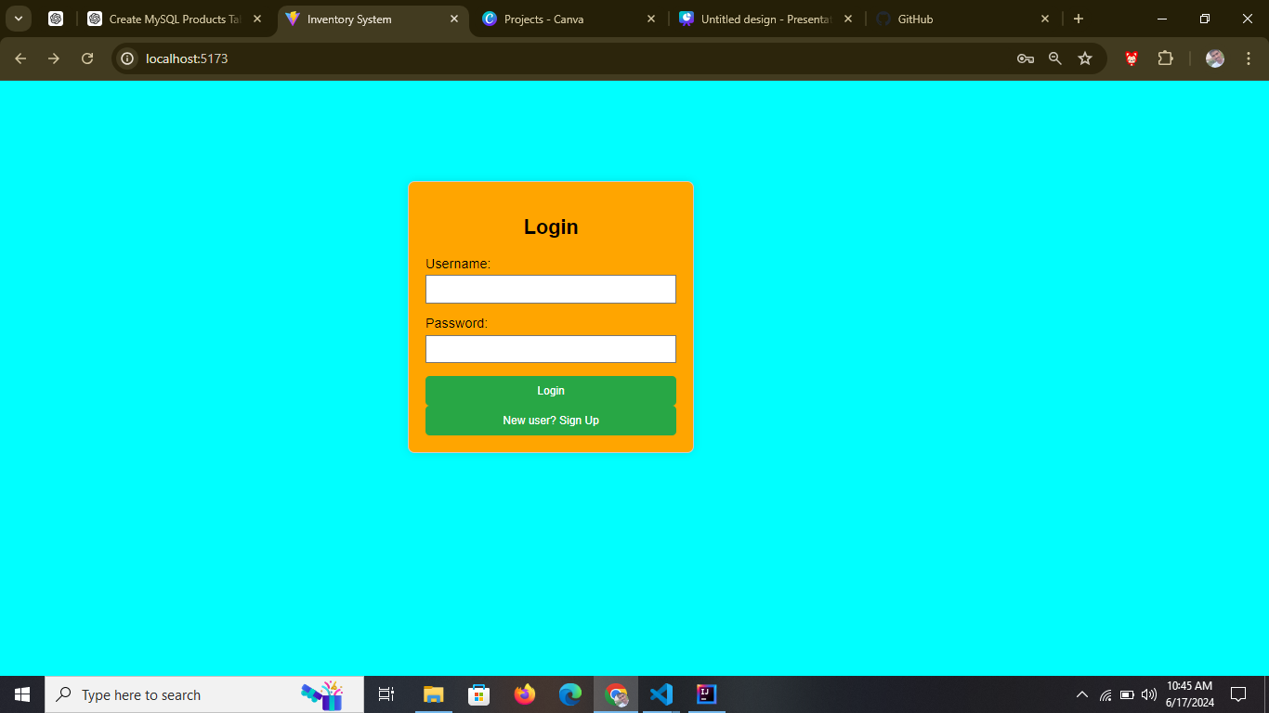
Inventory Management System

Slide 3
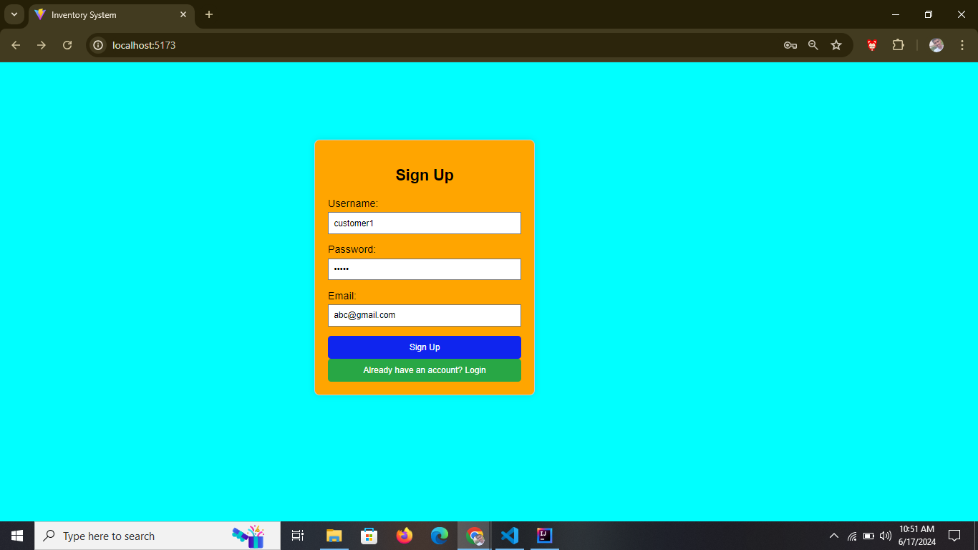
Inventory Management System

Slide 4
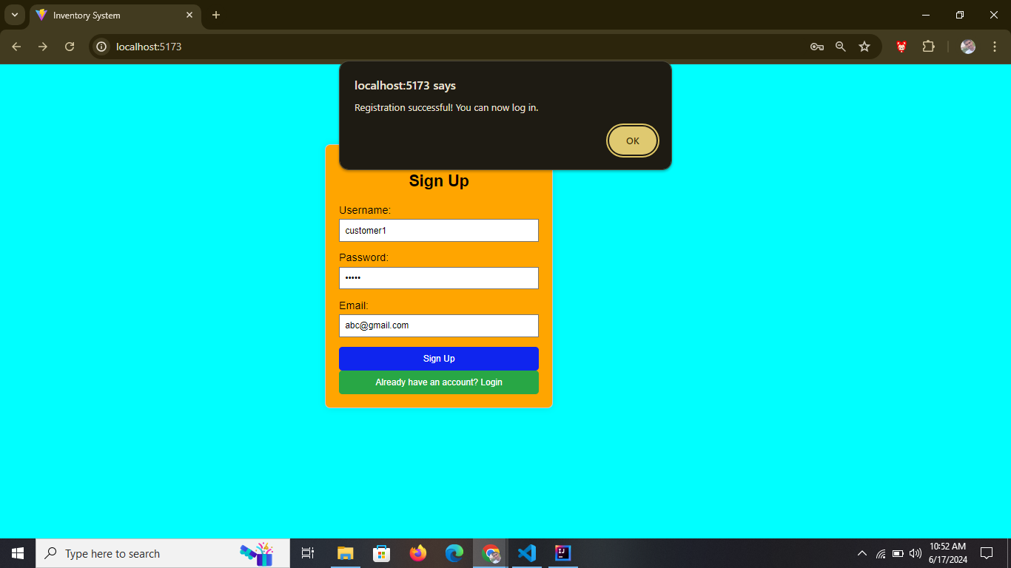
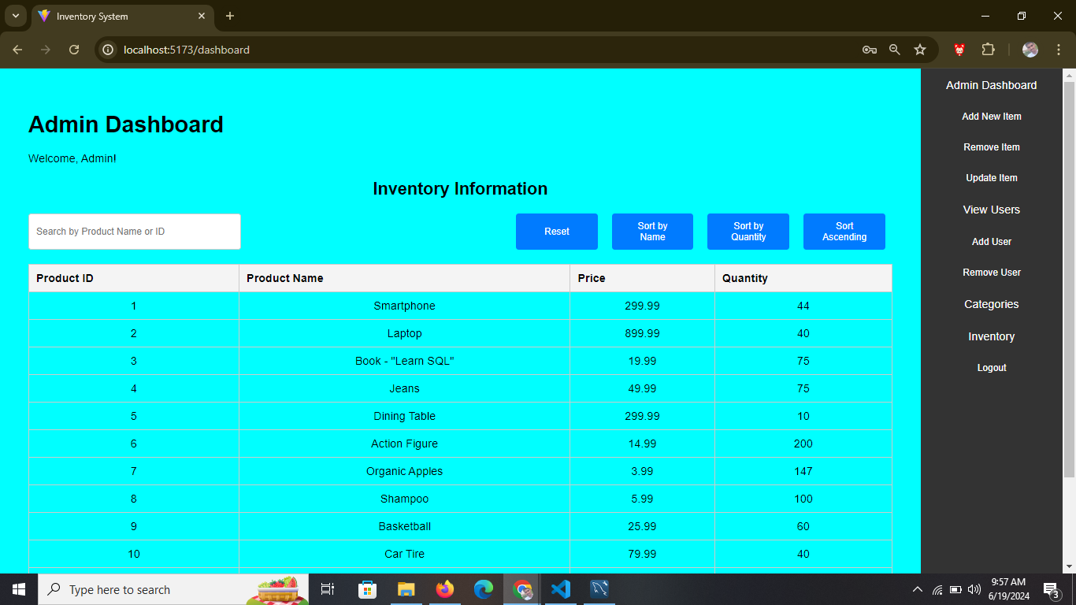
Inventory Management System

Slide 5

Inventory Management System

Slide 6

Inventory Management System

Slide 7

Inventory Management System

Slide 8
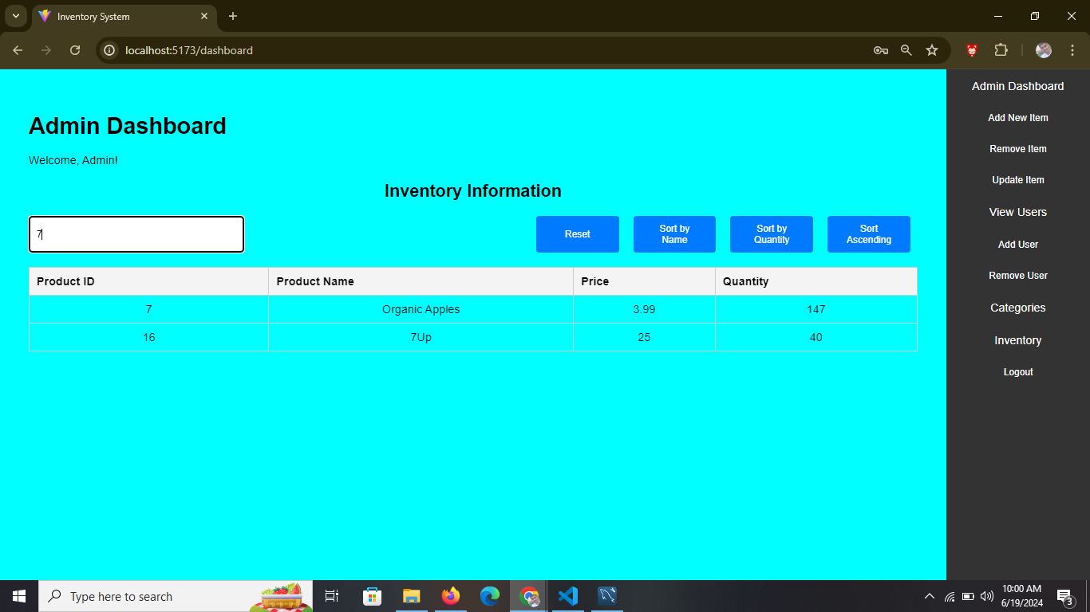
Inventory Management System

Slide 9
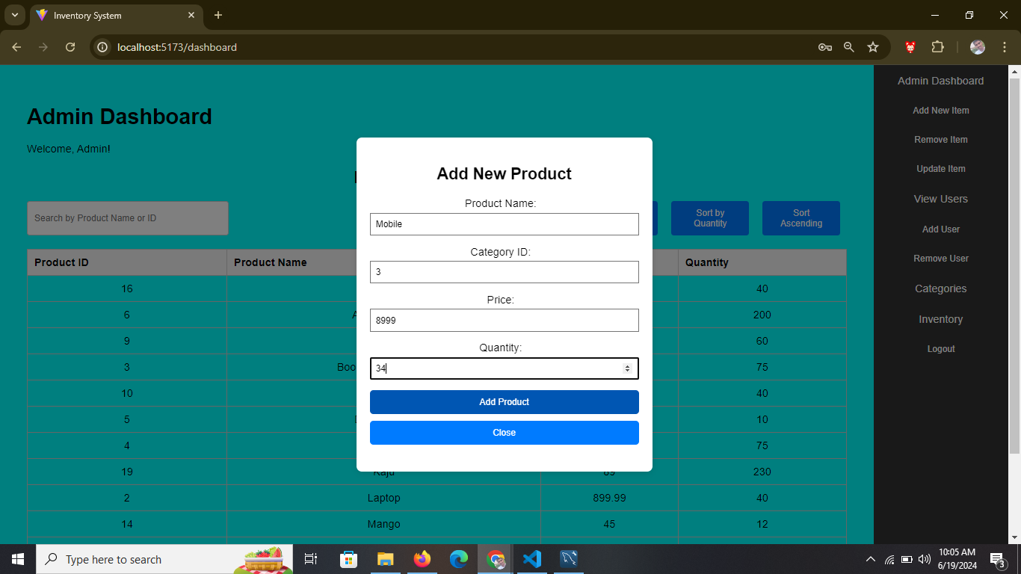
Inventory Management System

Slide 10
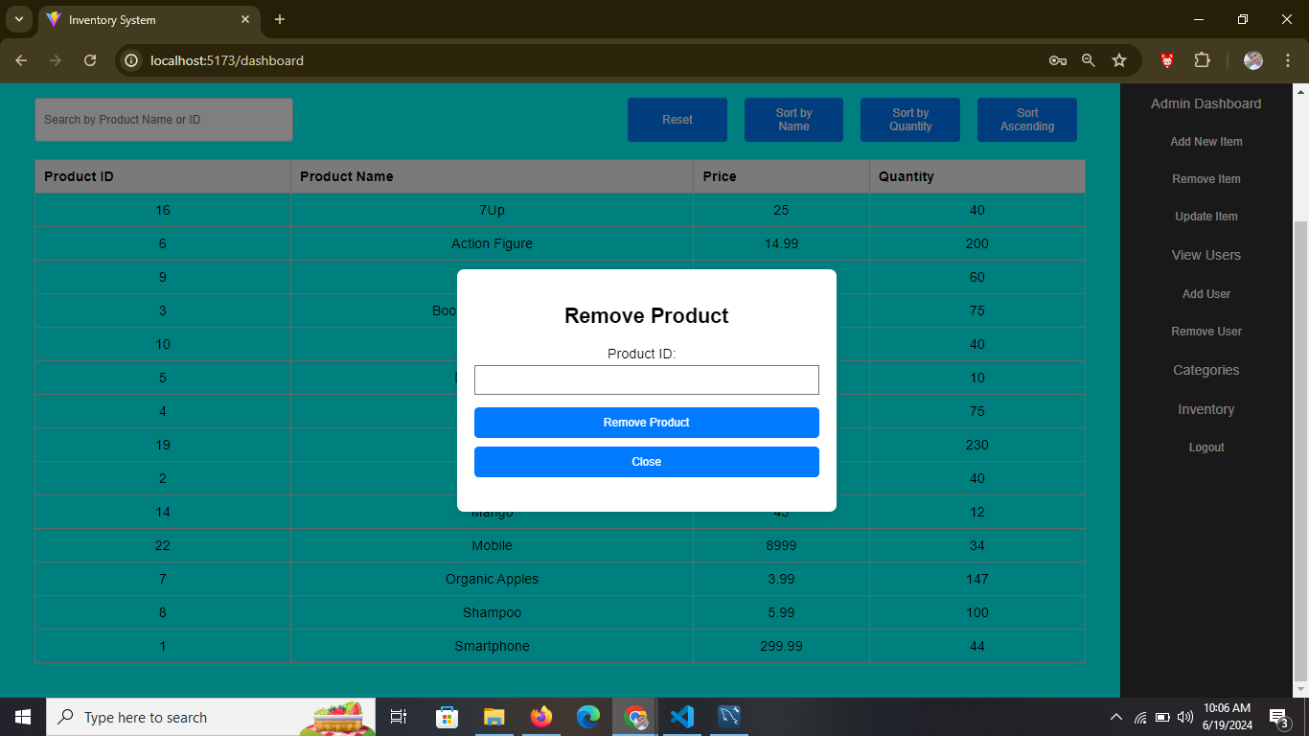
Inventory Management System

Slide 11
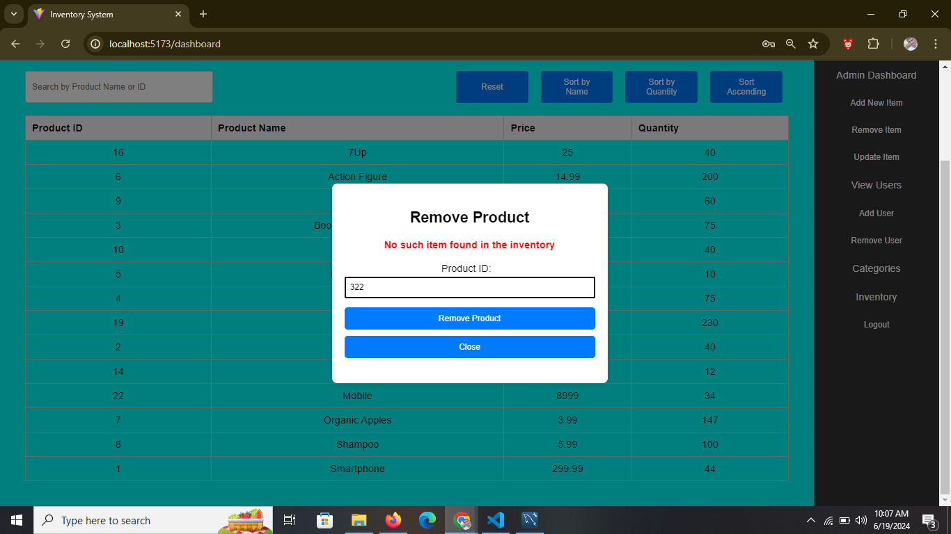
Inventory Management System

Slide 12
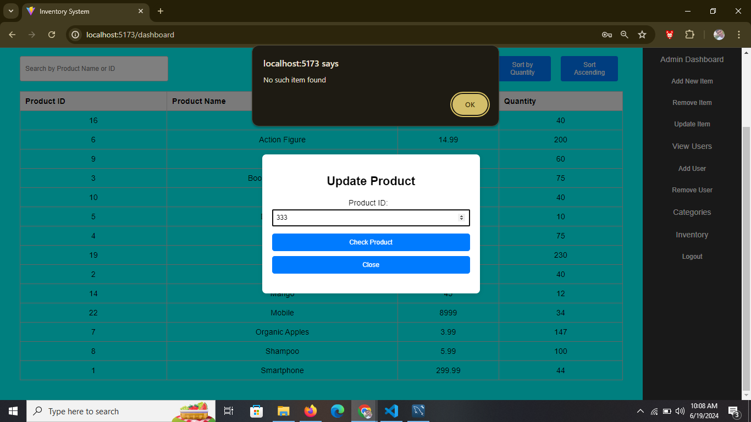
Inventory Management System

Slide 13
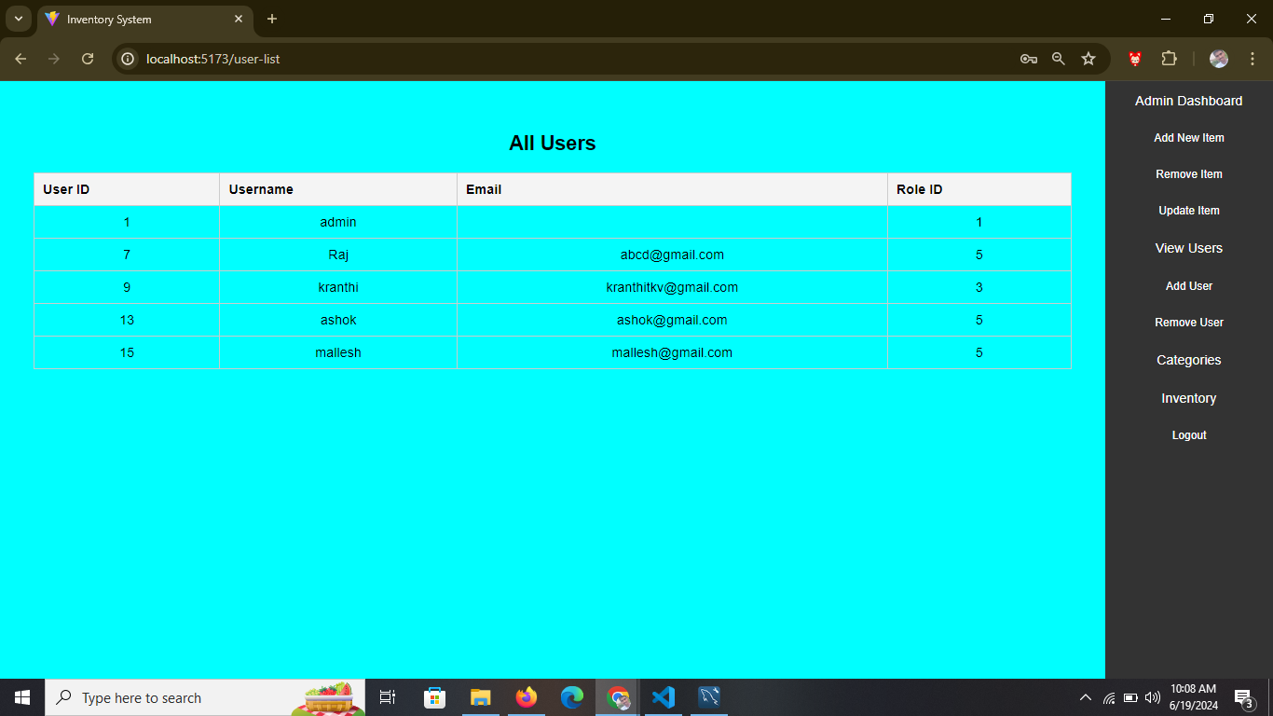
Inventory Management System

Slide 14
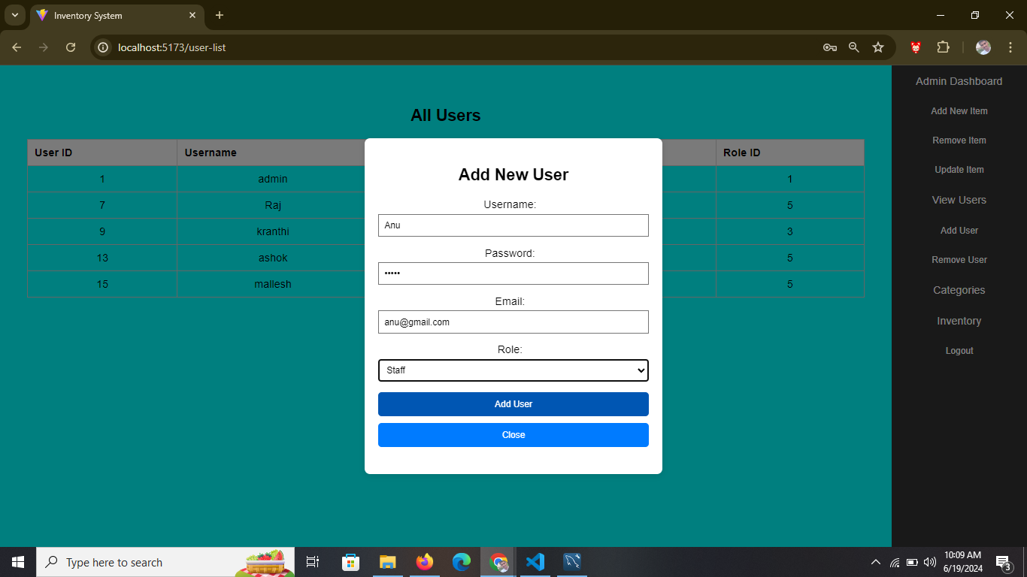
Inventory Management System

Slide 15

Inventory Management System

Slide 16
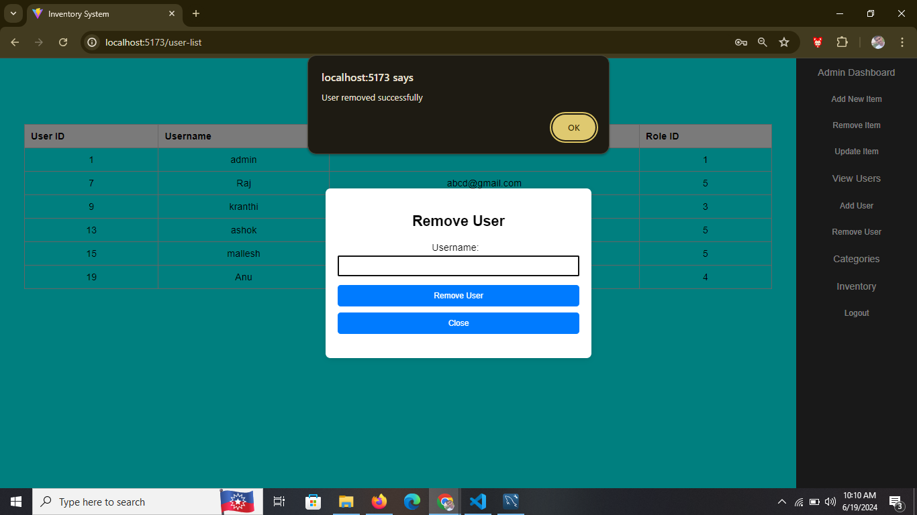
Inventory Management System

Slide 17
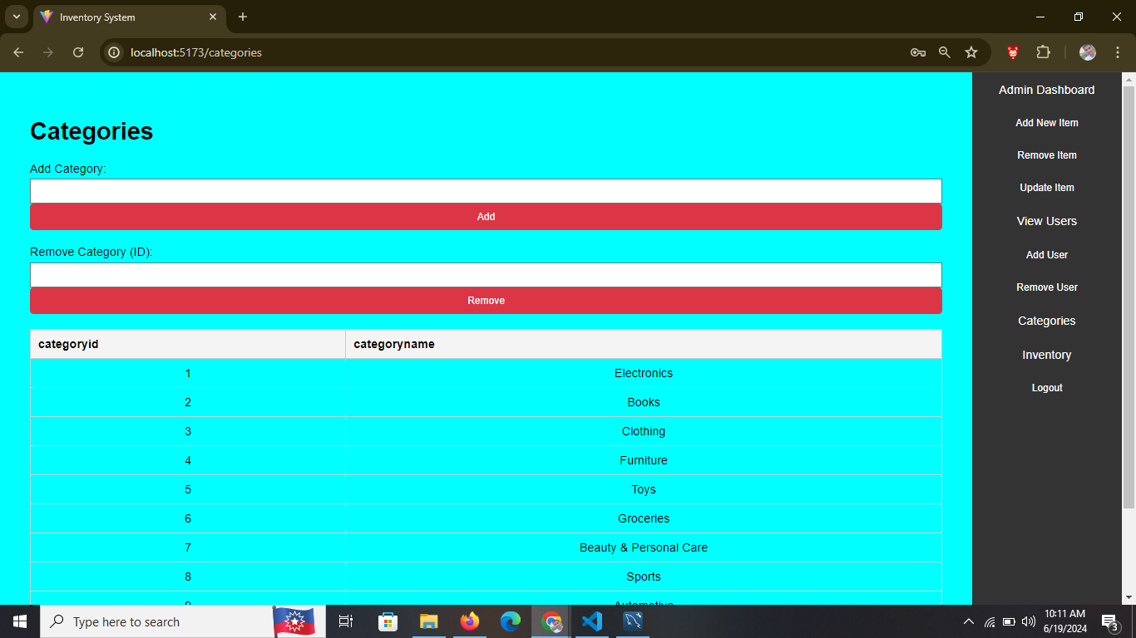
Inventory Management System

Slide 18
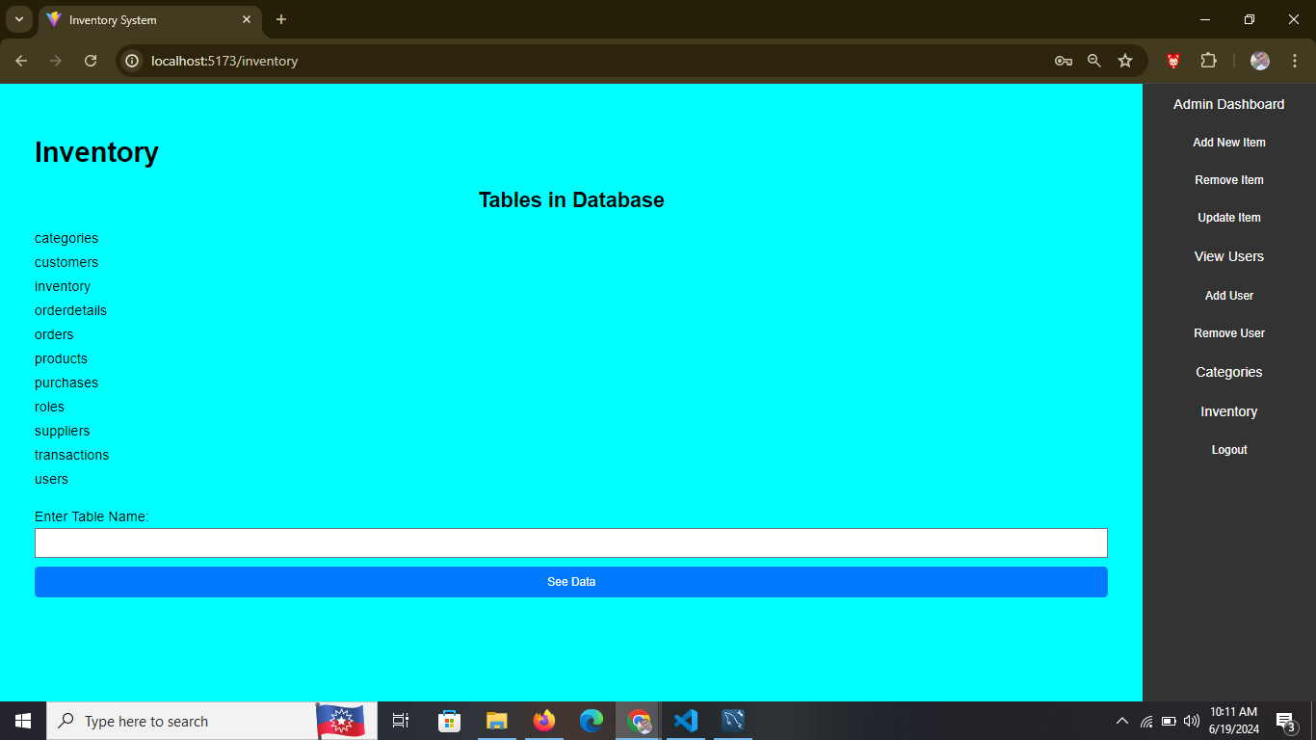
Inventory Management System

Slide 19
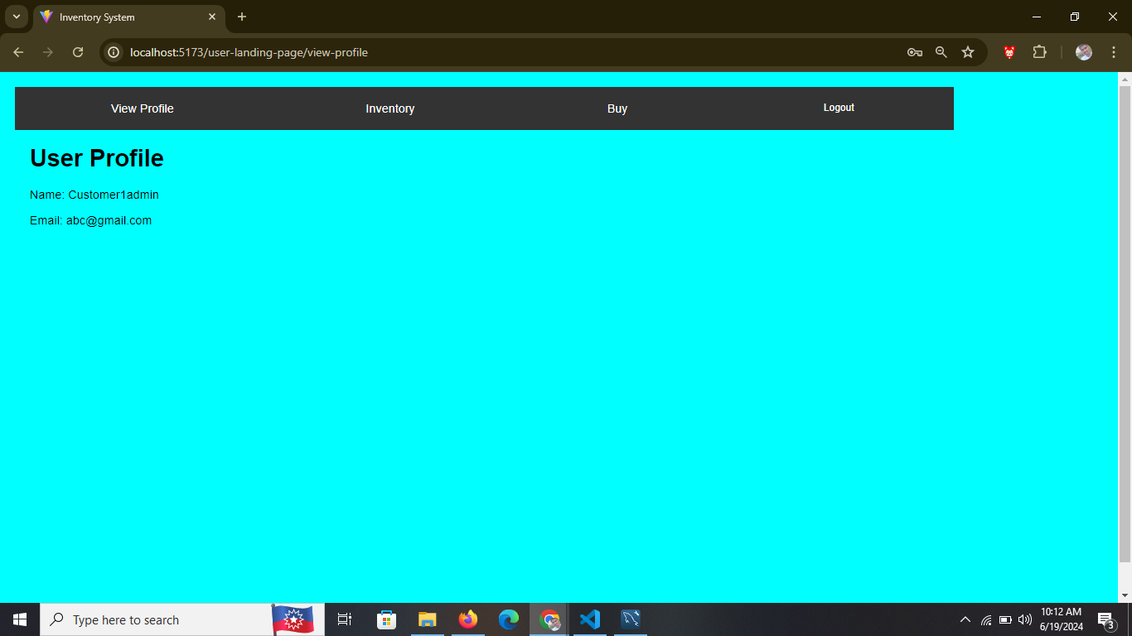
Inventory Management System

Slide 20
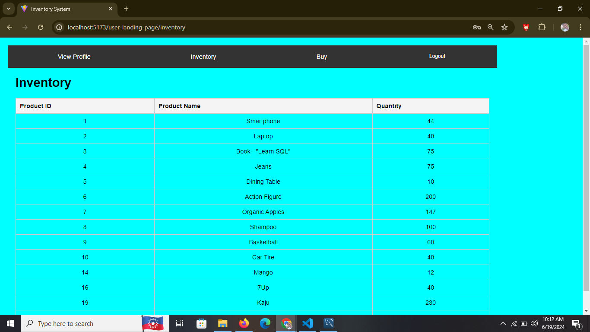
Inventory Management System

Slide 21
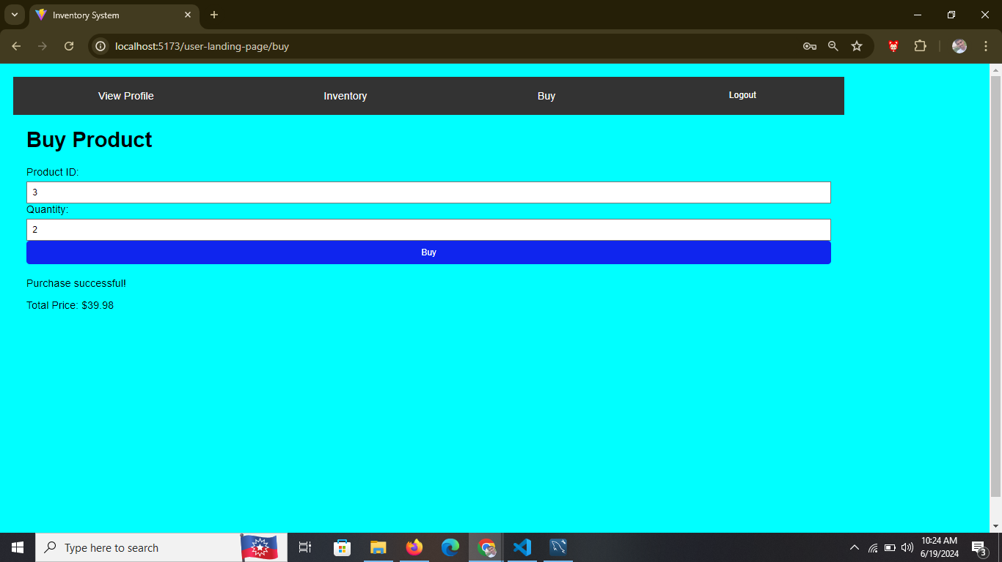
Inventory Management System

Slide 22

Q & A
Any Questions....

Slide 23

THANK YOU
Presented By,
B Mallesh
bavannagarimallesh@gmail.com

